Slide 1
Segmentation
Segmentation divides processes into smaller subparts known as modules.
Segmentation divides the user program and the secondary memory into uneven-sized blocks known as Segments.
The divided segments need not be placed in contiguous memory.
Since there is no contiguous memory allocation, internal fragmentation does not take place.
The length of the segments of the program and memory is decided by the purpose of the segment in the user program.
We can say that logical address space or the main memory is a collection of segments.

Slide 2
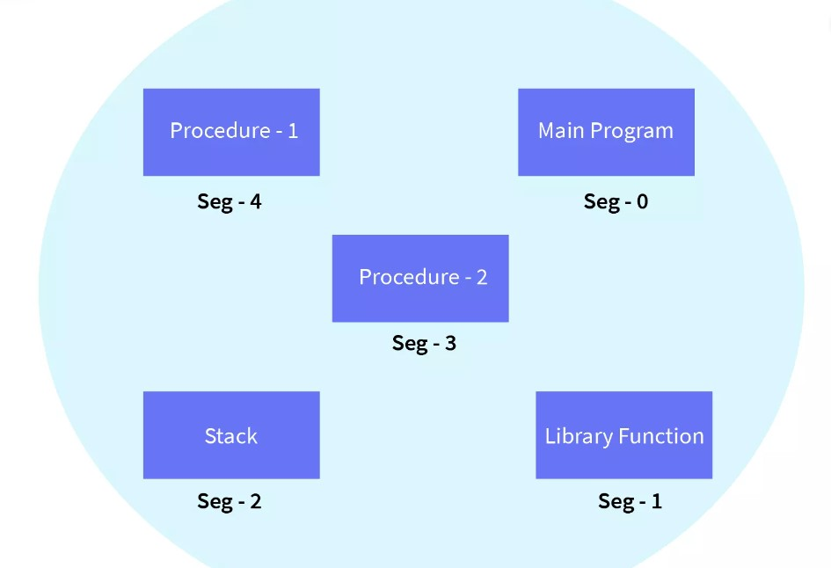

Slide 3
Why segmentation required?
Segmentation came into existence because of the problems in the paging technique.
In the case of the paging technique, a function or piece of code is divided into pages without considering that the relative parts of code can also get divided.
Hence, for the process in execution, the CPU must load more than one page into the frames so that the complete related code is there for execution.
Paging took more pages for a process to be loaded into the main memory.
Hence, segmentation was introduced in which the code is divided into modules so that related code can be combined in one single block.

Slide 4
Segment Table and its Uses
Segment Table is used to store the information of all segments of the process. As we know, the CPU generates a logical address and for its conversion to the physical address, a segment table is used. The mapping of a two-dimensional Logical address to the one-dimensional Physical address is done using the segment table.
The Segment Table has two components:
Segment Base: The segment base is also known as the base address of a segment. The segment base contains the starting physical address of the segments residing in the memory.
Segment Limit: The segment limit is also known as segment offset. The segment contains the specific length of the segment.

Slide 5
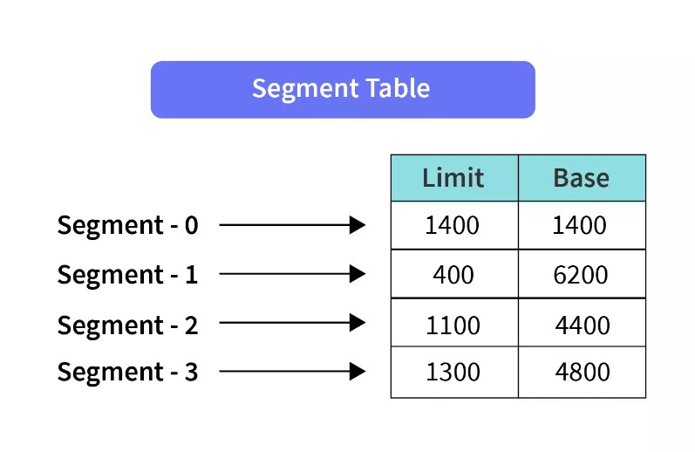
STBR: STBR stands for Segment Table Base Register. STBR stores the base address of the segment table.
STLR: STLR stands for Segment Table Length Register. STLR stores the number of segments used by a program.

Slide 6
Characteristics of Segmentation
Segmentation partitions the program into variable-sized blocks or segments.
Partition size depends upon the type and length of modules.
Segmentation is done considering that the relative data should come in a single segment.
Segments of the memory may or may not be stored in a continuous manner depending upon the segmentation technique chosen.
Operating System maintains a segment table for each process.

Slide 7
Example of segmentation
Let us assume we have five segments namely: Segment-0, Segment-1, Segment-2, Segment-3, and Segment-4. Initially, before the execution of the process, all the segments of the process are stored in the physical memory space. We have a segment table as well. The segment table contains the beginning entry address of each segment (denoted by base). The segment table also contains the length of each of the segments (denoted by limit).
As shown in the image below, the base address of Segment-0 is 1400 and its length is 1000, the base address of Segment-1 is 6300 and its length is 400, the base address of Segment-2 is 4300 and its length is 400, and so on.
The pictorial representation of the above segmentation with its segment table is shown below.

Slide 8
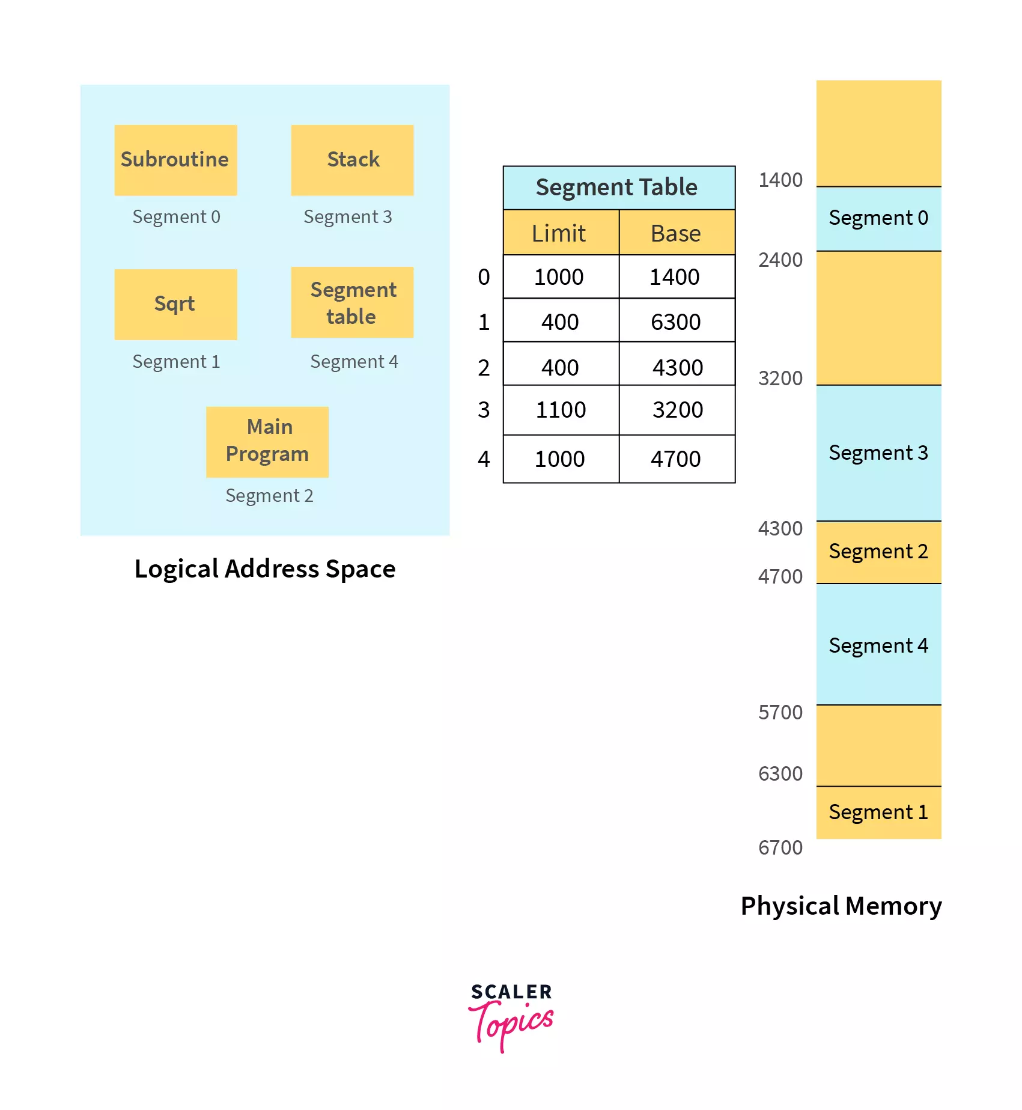



Slide 9
Virtual memory
Virtual memory is hardware technique where the system appears to have more memory that it actually does.
It is a storage mechanism which offers user an illusion of having a very big main memory.
It is done by treating a part of secondary memory as the main memory.
In Virtual memory, the user can store processes with a bigger size than the available main memory.
Therefore, instead of loading one long process in the main memory, the OS loads the various parts of more than one process in the main memory.
Virtual memory is mostly implemented with demand paging and demand segmentation.

Slide 10
Why Need Virtual Memory?
Here, are reasons for using virtual memory:
Whenever your computer doesn’t have space in the physical memory it writes what it needs to remember to the hard disk in a swap file as virtual memory.
If a computer running Windows needs more memory/RAM, then installed in the system, it uses a small portion of the hard drive for this purpose.

Slide 11
How Virtual Memory Works?
It is used whenever some pages require to be loaded in the main memory for the execution, and the memory is not available for those many pages.
So, in that case, instead of preventing pages from entering in the main memory, the OS searches for the RAM space that are minimum used in the recent times or that are not referenced into the secondary memory to make the space for the new pages in the main memory.
Let’s understand virtual memory management with the help of one example.

Slide 12
For example:
Let’s assume that an OS requires 300 MB of memory to store all the running programs. However, there’s currently only 50 MB of available physical memory stored on the RAM.
The OS will then set up 250 MB of virtual memory and use a program called the Virtual Memory Manager(VMM) to manage that 250 MB.
So, in this case, the VMM will create a file on the hard disk that is 250 MB in size to store extra memory that is required.
The OS will now proceed to address memory as it considers 300 MB of real memory stored in the RAM, even if only 50 MB space is available.
It is the job of the VMM to manage 300 MB memory even if just 50 MB of real memory space is available.

